Slide 1


Data Visualization for Product Design
By:
Ekamjot singh(23117010)
Divyansh(23117009)
Harshit Dhingra(23117014)
Akshay Jain(23117016)
Happy Yadav(23106039)

Slide 2

1-Understand the objective
2-Data Collection
3-Data Preprocessing and cleaning
4-Data analysis and visualization
5-User interface design
6-Thanks
Data
Visualization

Slide 3
01 – Understanding the objective
GOAL: Visualize the number of publications by the CSE department over different years, by different faculty members, and in various journals/conferences.
Deliverables: Interactive and static visualizations, such as bar charts, pie charts, Sankey diagrams, and line charts.
Target Audience: Faculty, researchers, and students.

Slide 4
DATA COLLECTION
DATA HAS BEEN COLLECTED FROM SOURCE LIKE NITJ WEBSITE FOR FACULTY OF CSE DEPARTMENT
DATA WAS INTIALLY IN .XLX FORM WHICH WAS THEN CONVERTED TO CSV FORMAT FOR SMOOTH FUNCTIONING OF PYTHON LIBRARIES IN FORM OF TABLE
DATA FILES WILL BE ATTACHED ALONGSIDE PPT

Slide 5
Data preprocessing and cleaning
Handling Missing Values:
Correcting Inconsistent Values: .
Tokenizing Attributes:

Slide 6
Data analysis and visualization
This include use of various python libraries ….
Matplot.lib
Pandas
Wordcloud
Pyplot
Numpy

Slide 7
User interface design
Ppt has been made for all visualized graphs

Slide 8
Line charts for journals
Data is preprocessed as some instances of year attribute have null values
Publications per year is visualized
Trends can be visualized for each faculty

Slide 9
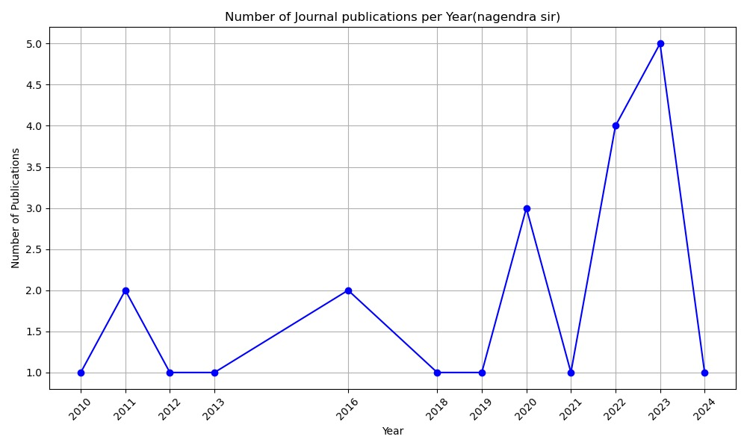
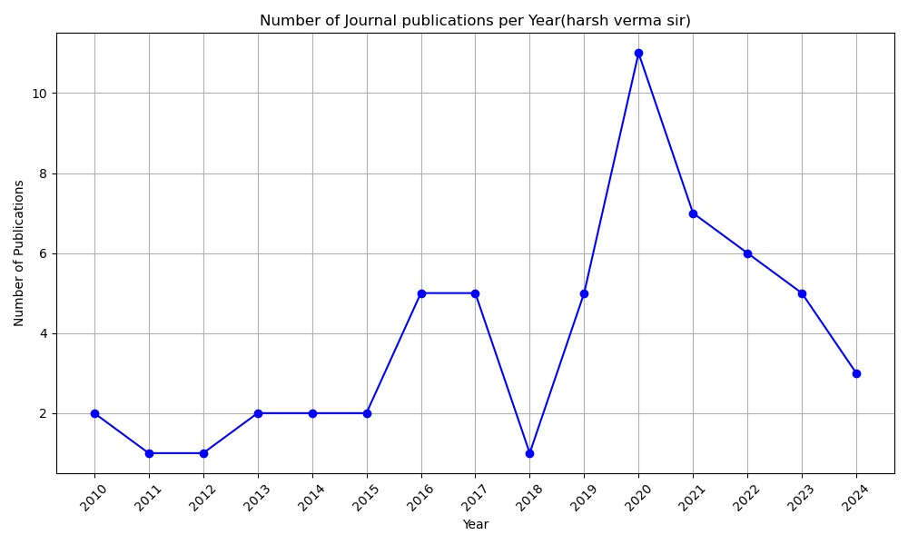
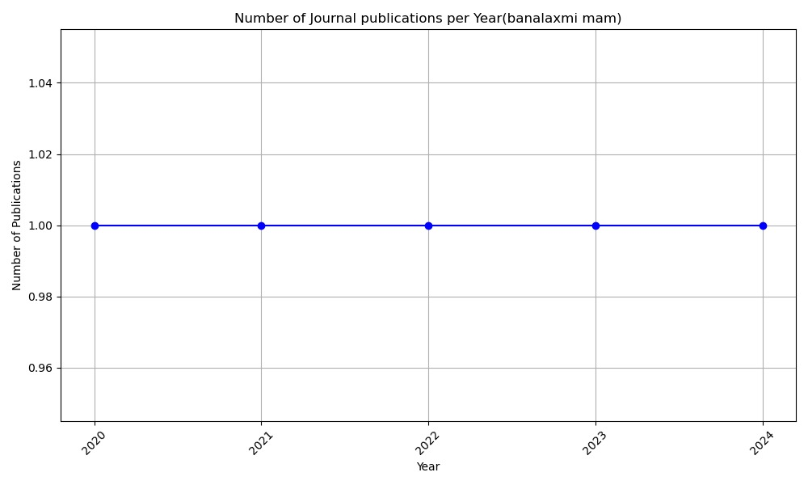
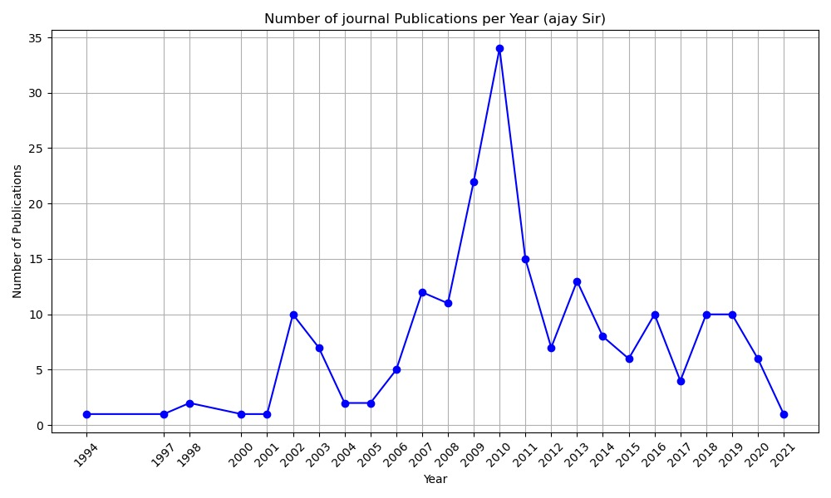

Slide 10
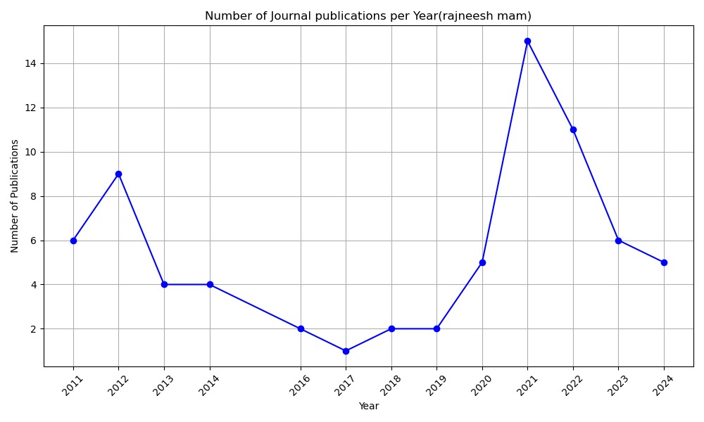
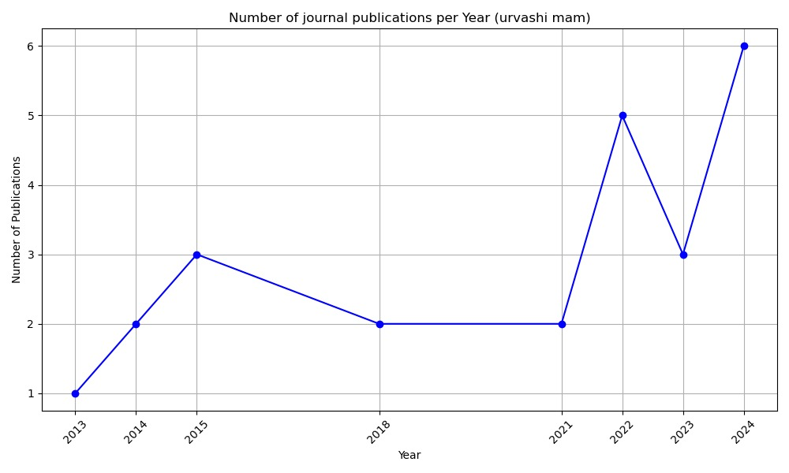
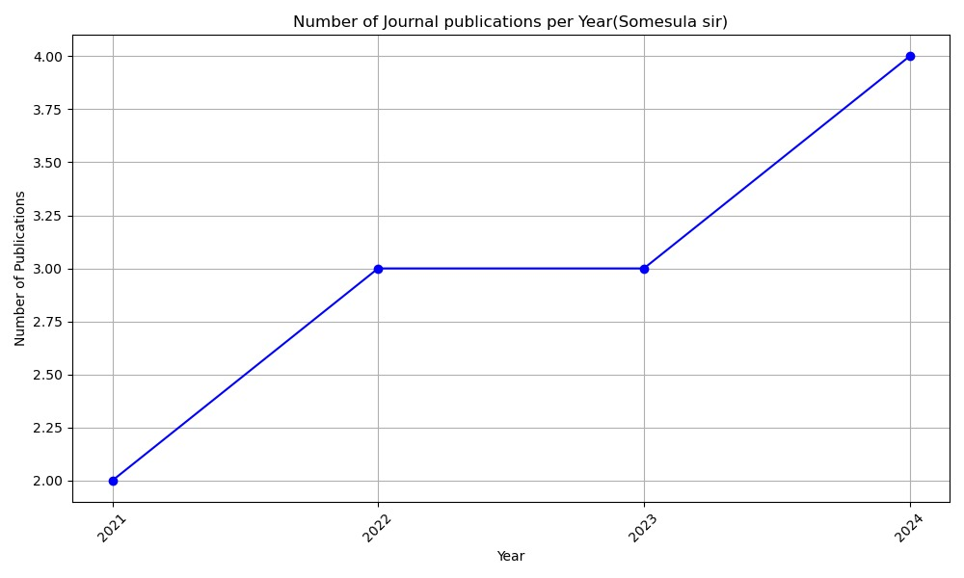
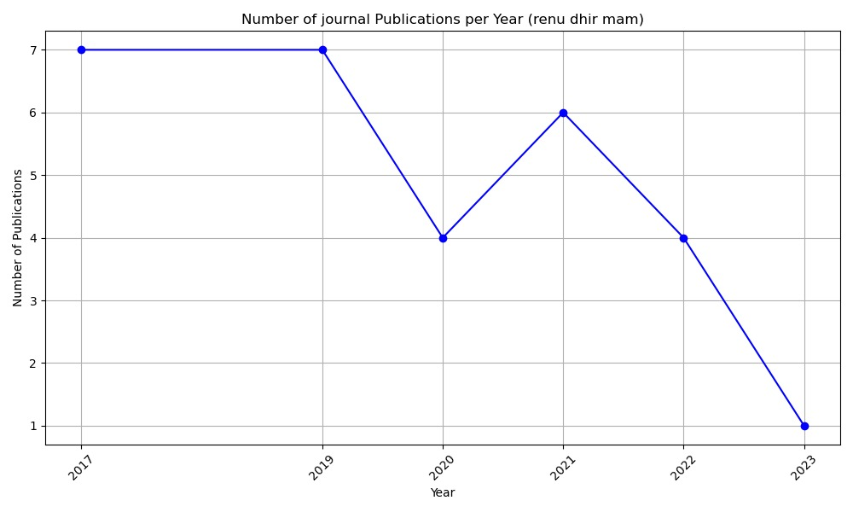

Slide 11
Line charts for conference
Data is preprocessed as some instances of year attribute have null values
Publications per year is visualized
Trends can be visualized for each faculty

Slide 12
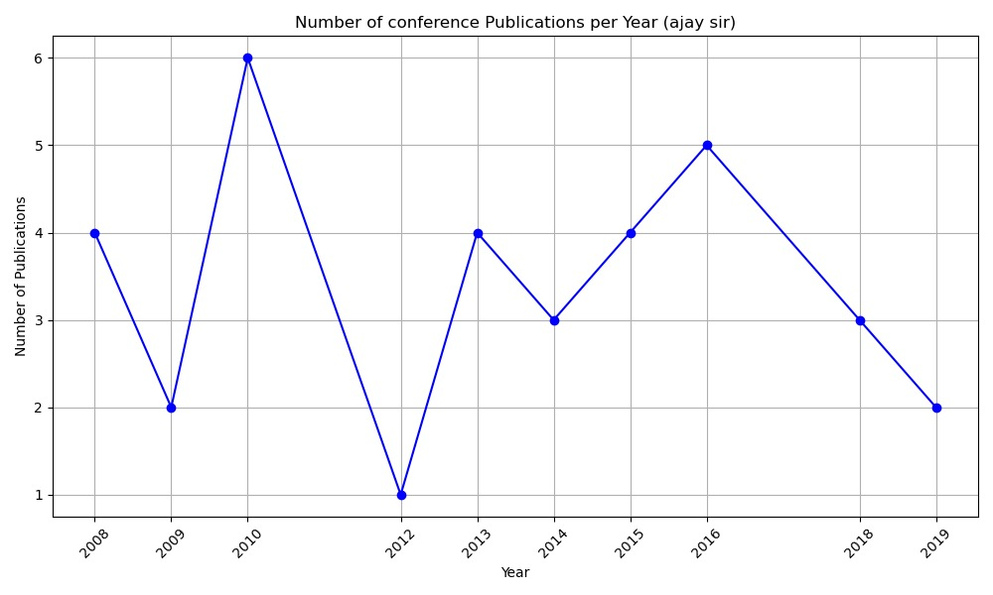
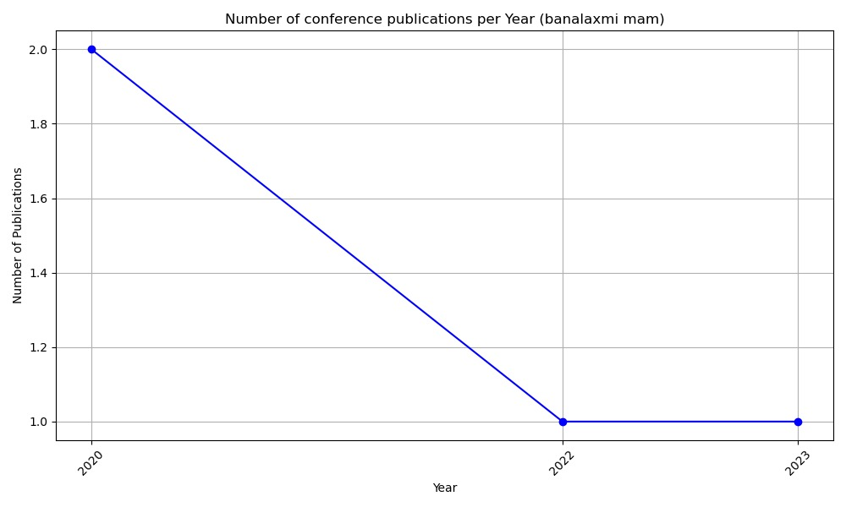
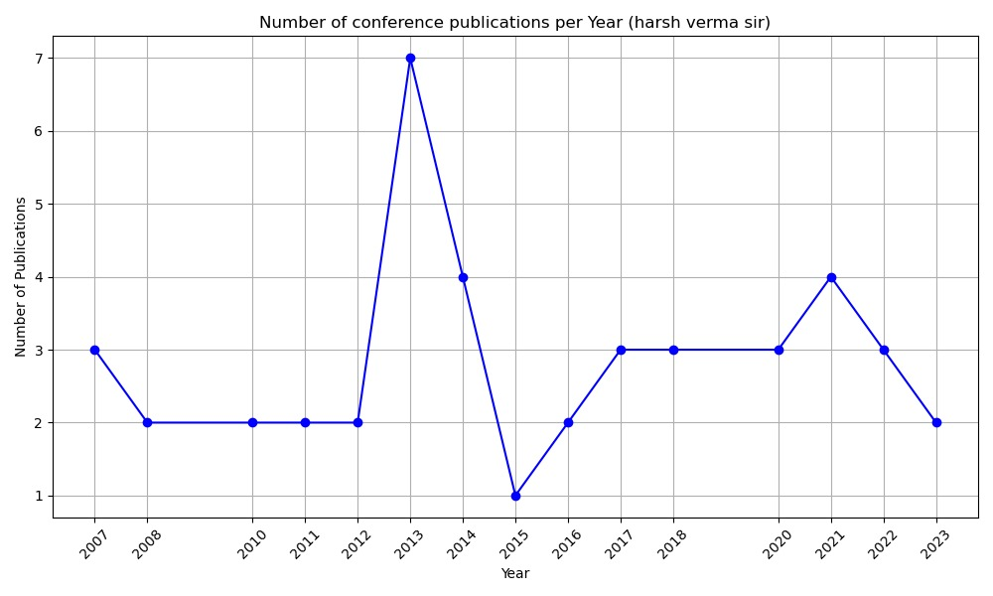

Slide 13
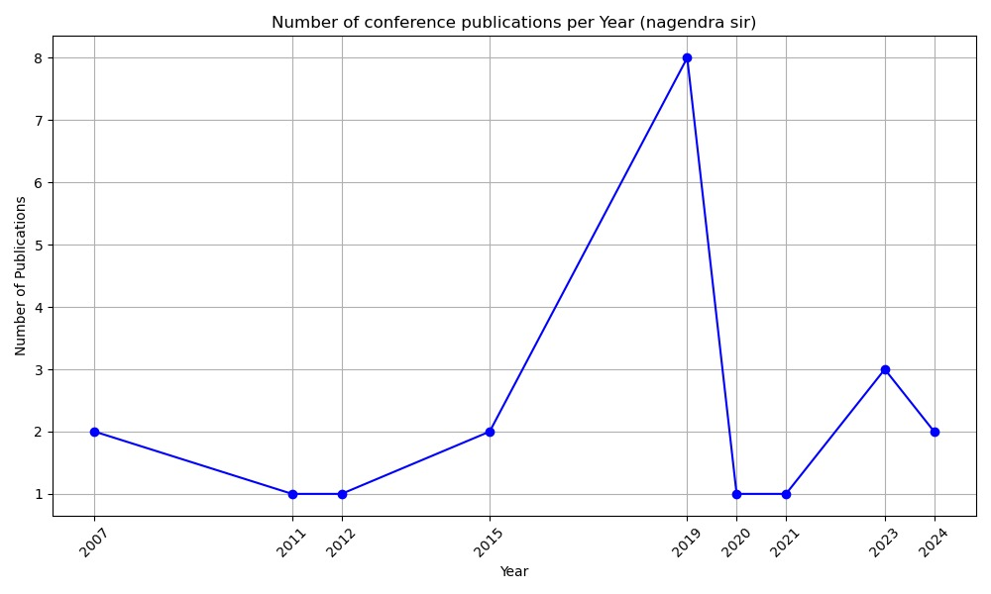
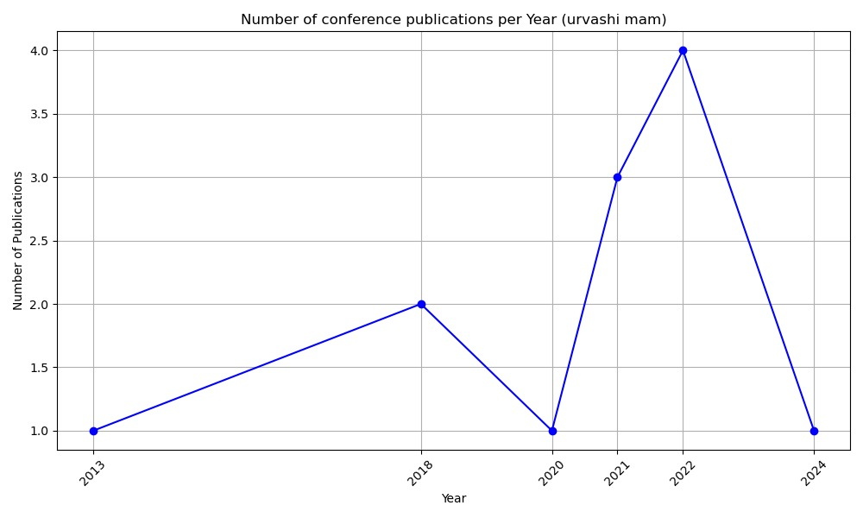
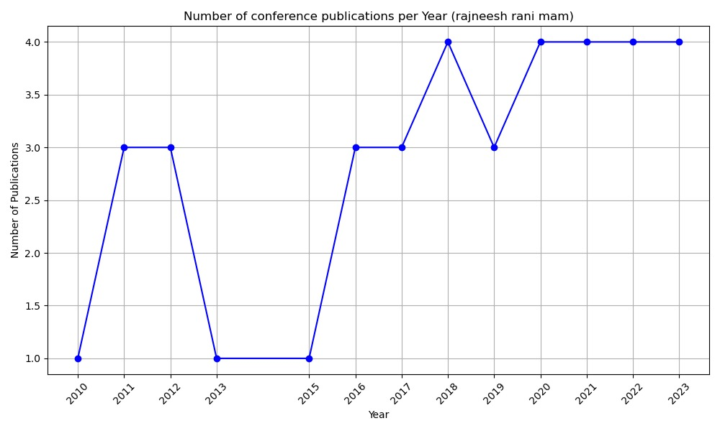
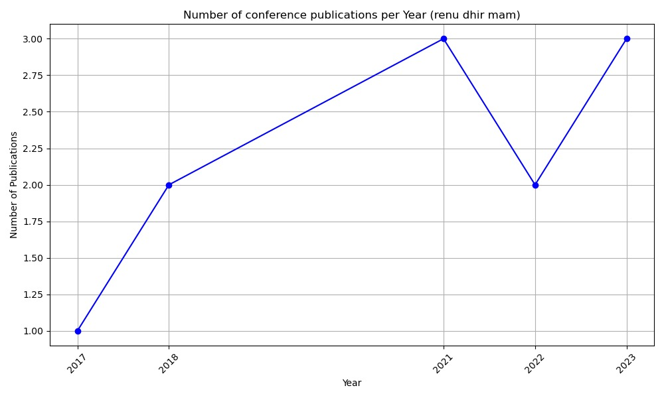

Slide 14
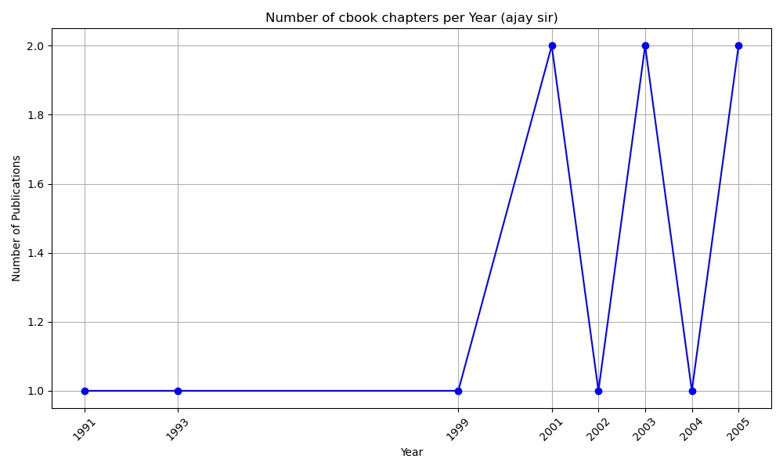
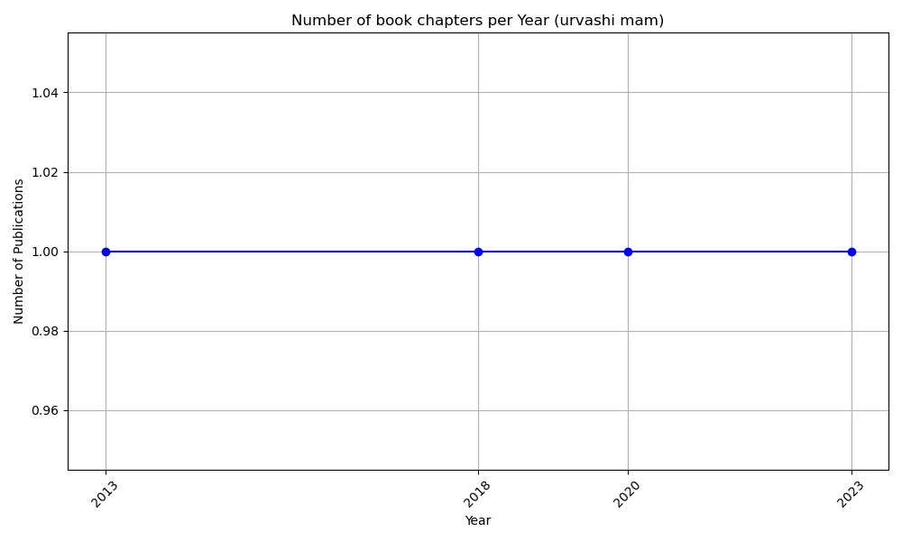
Line charts for Book Chapters

Slide 15
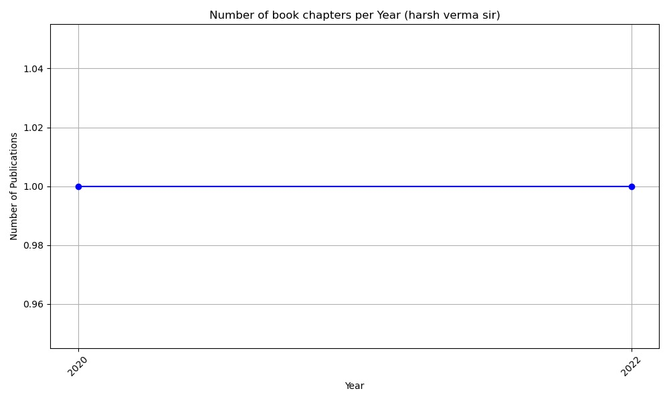
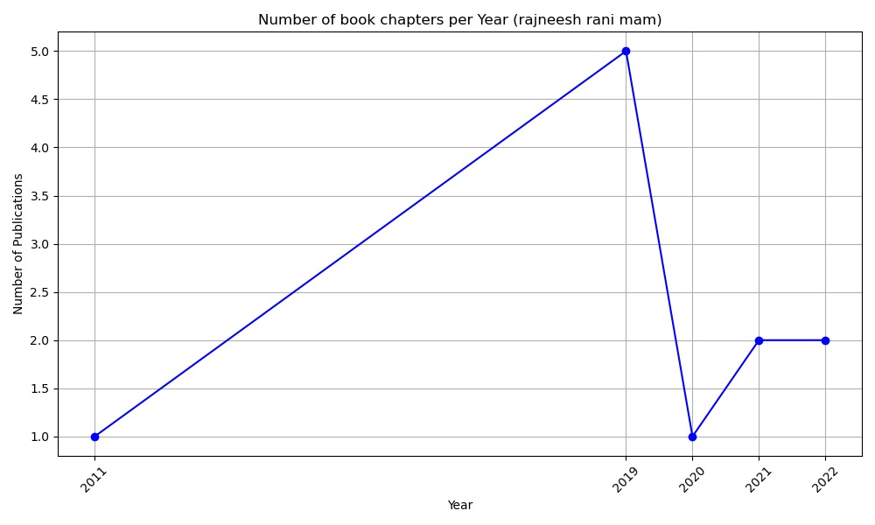
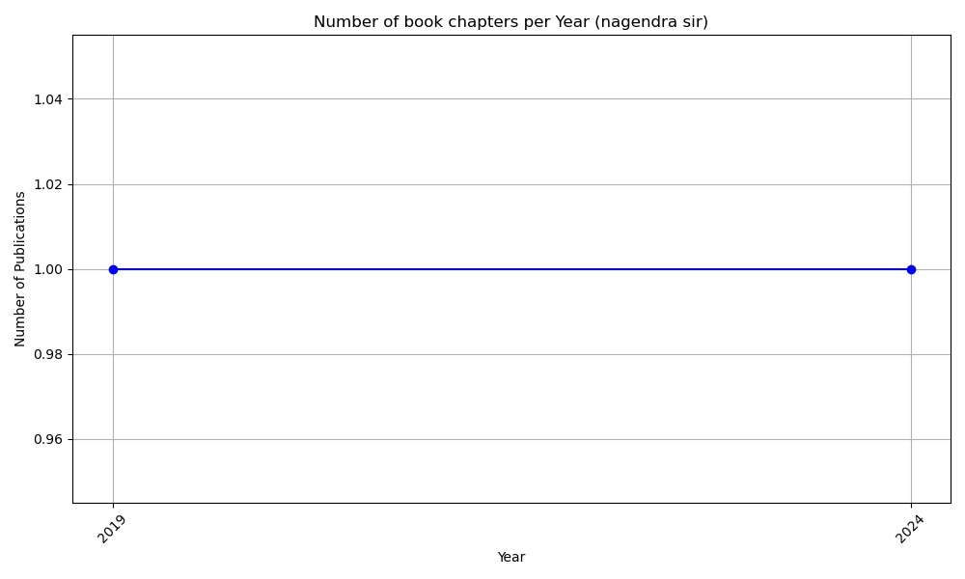
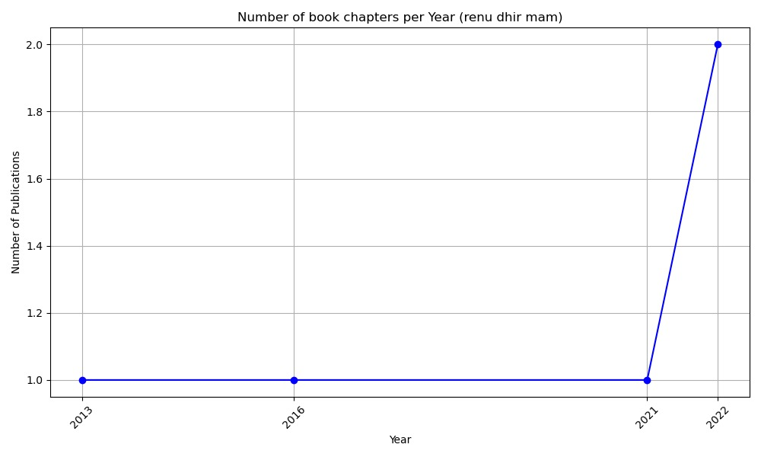

Slide 16
PIE CHARTS FOR INDIVIDUAL FACULTY
Data is visualized in proportional way
It shows composition between journals ,conferences, book chapters, research project.

Slide 17
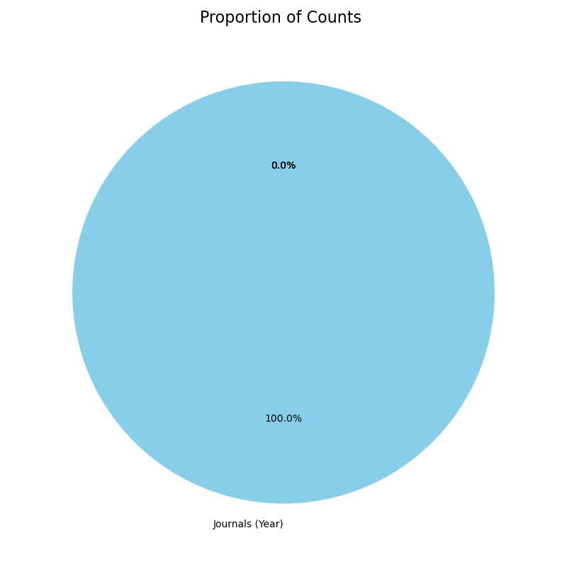
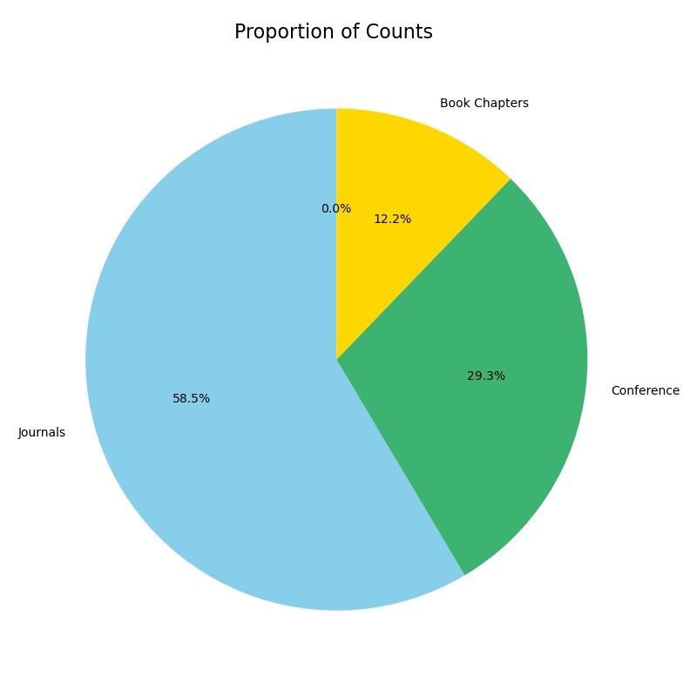
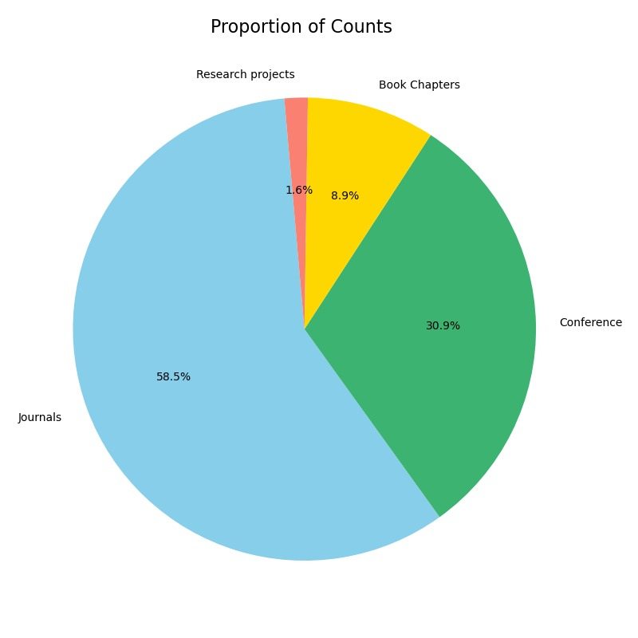
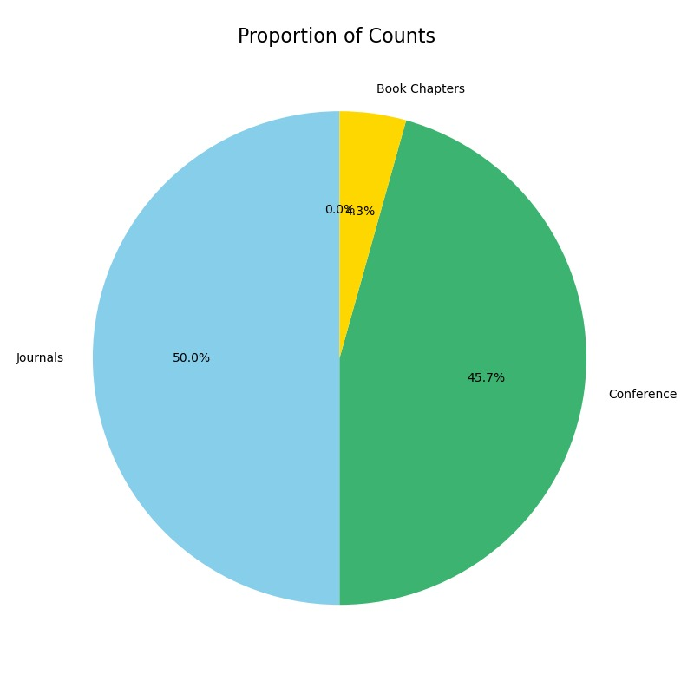
SSOMESULA SIR
URVASHI MAM
RAJNEESH MAM
NAGENDRA SIR

Slide 18
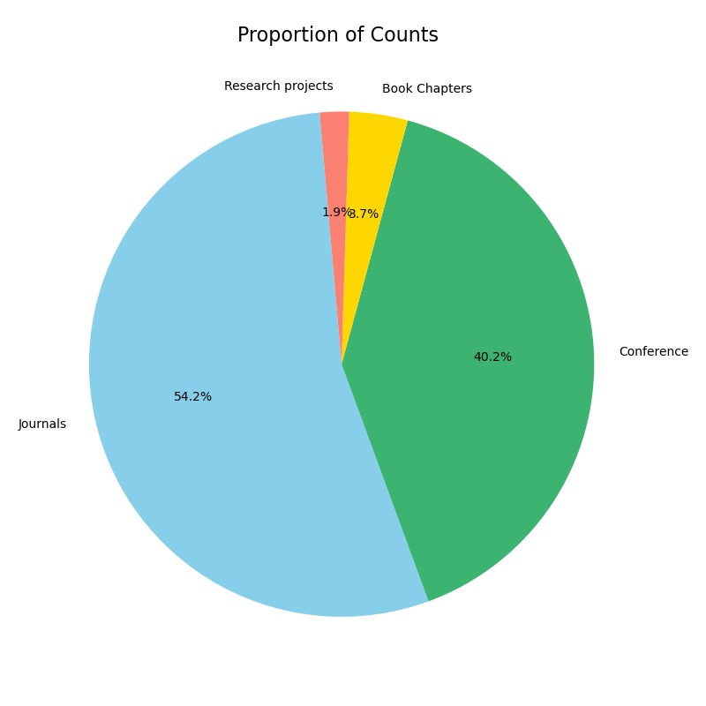
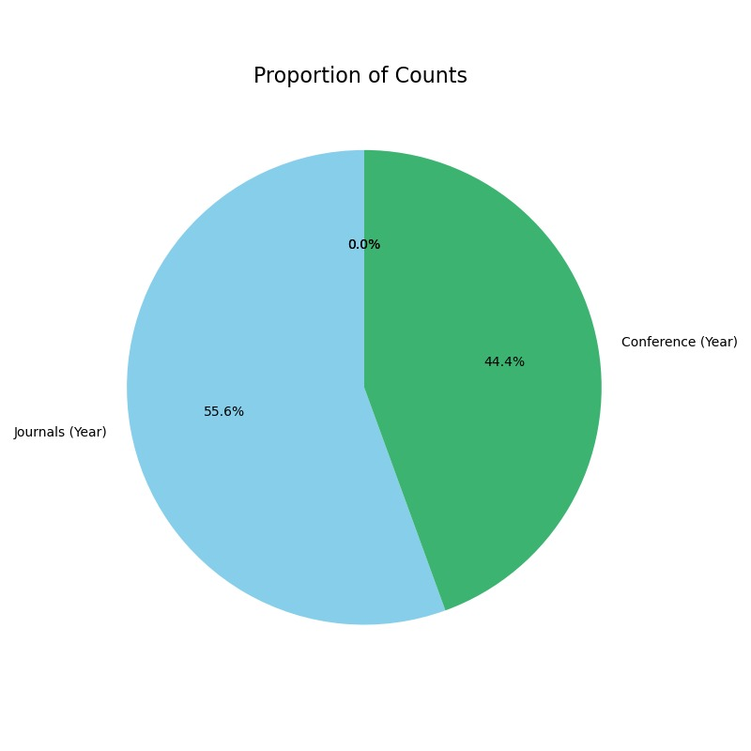
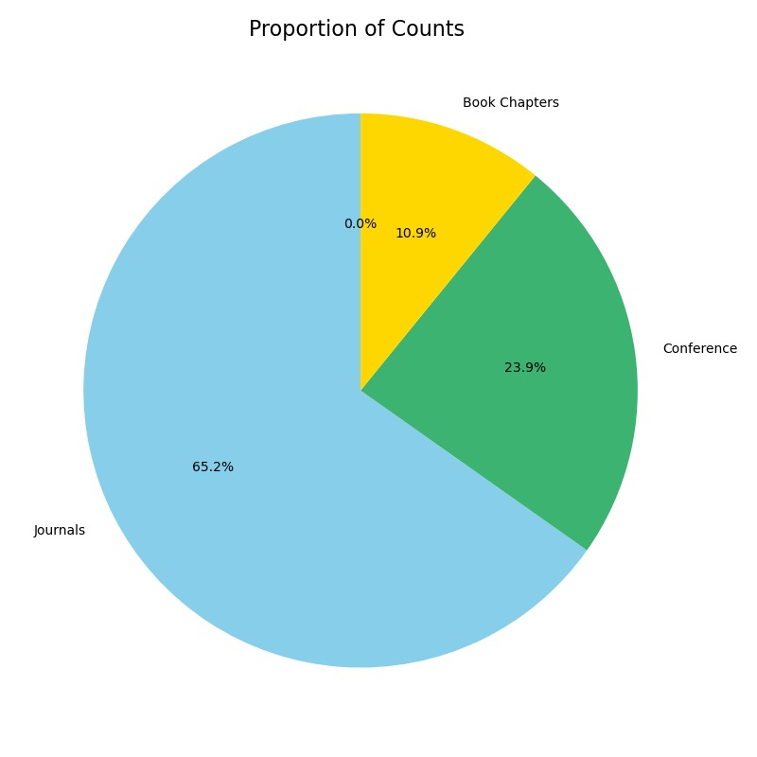
BANALAXMI MAM
HARSH VERMA SIR
RENU DHIR MAM

Slide 19
PIE CHART FOR ALL FACULTY
Data is visualized in proportional way
It shows composition between journals ,conferences, book chapters, research project for all faculty in consideration.

Slide 20
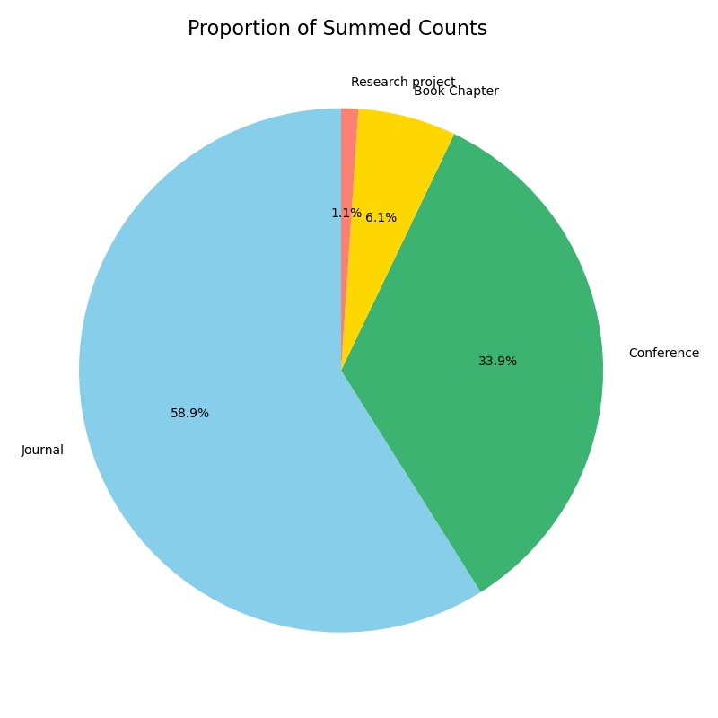

Slide 21
Word cloud
Data is visualized in priority manner.
It shows number of collaboration with a specific faculty and also shows the topic which they have favored in their research

Slide 22
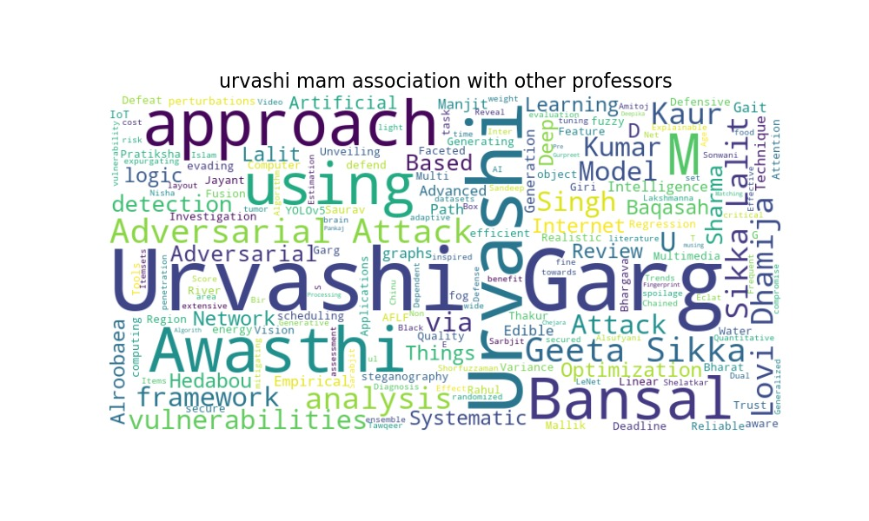
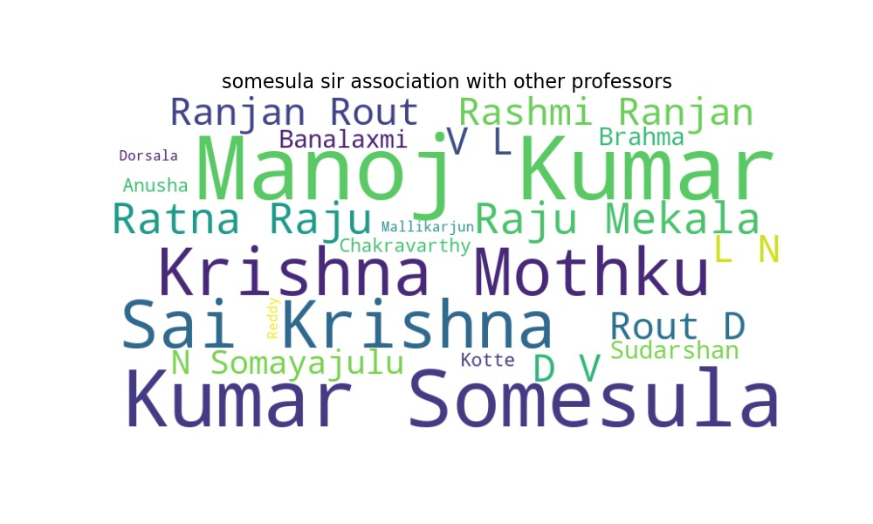
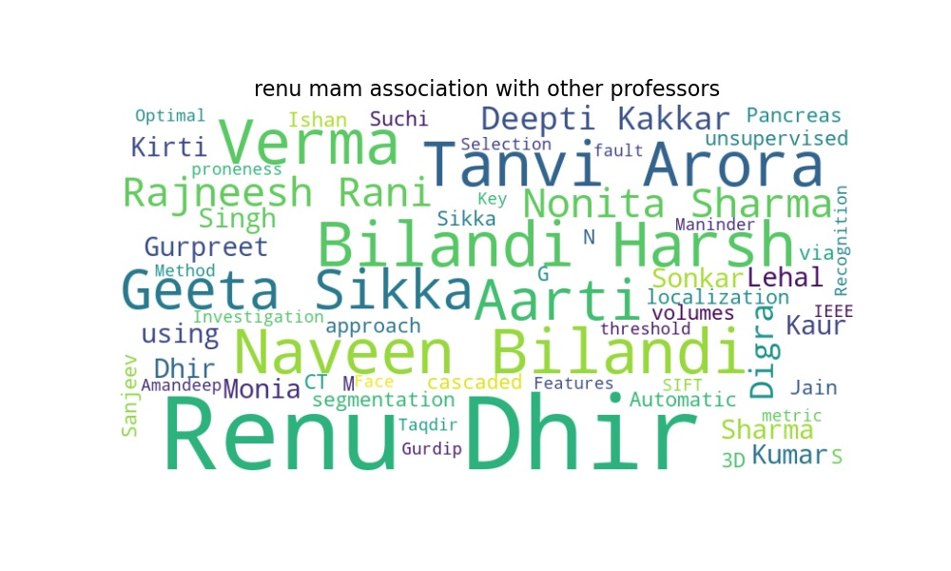
For Journals

Slide 23
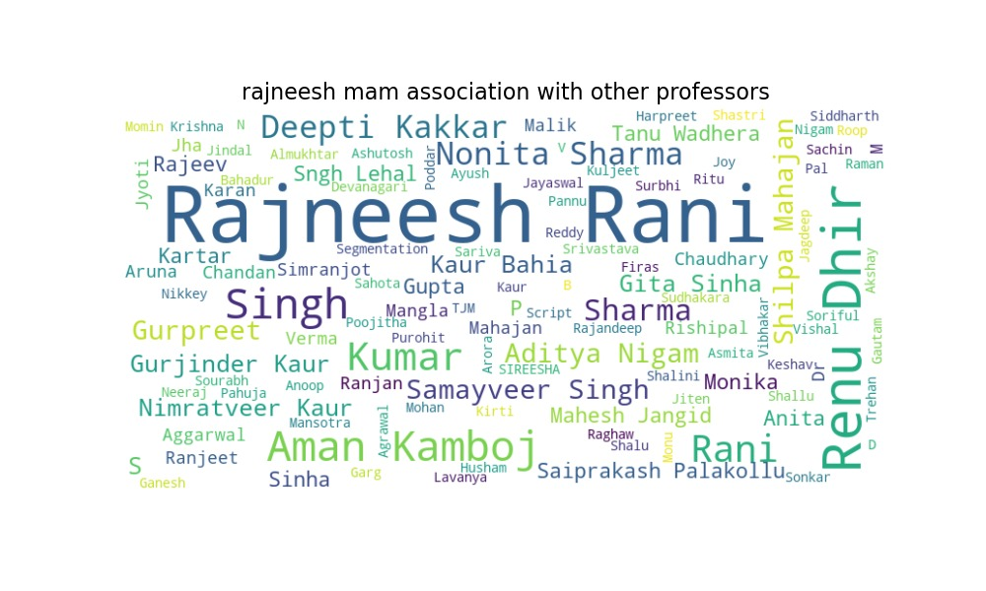
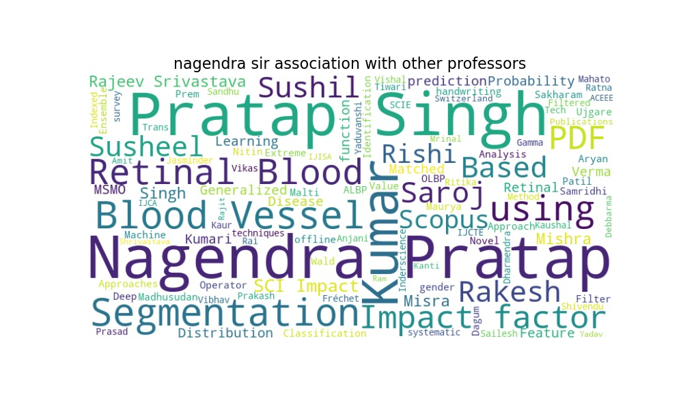
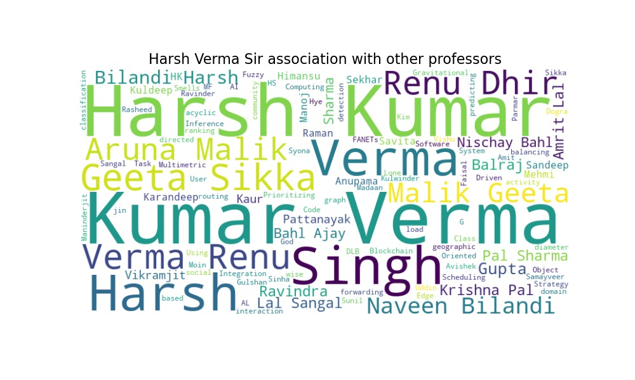
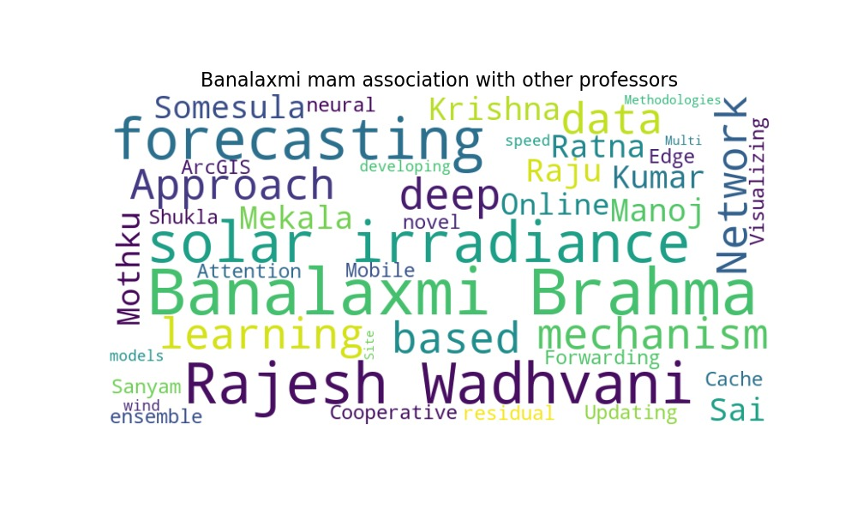

Slide 24

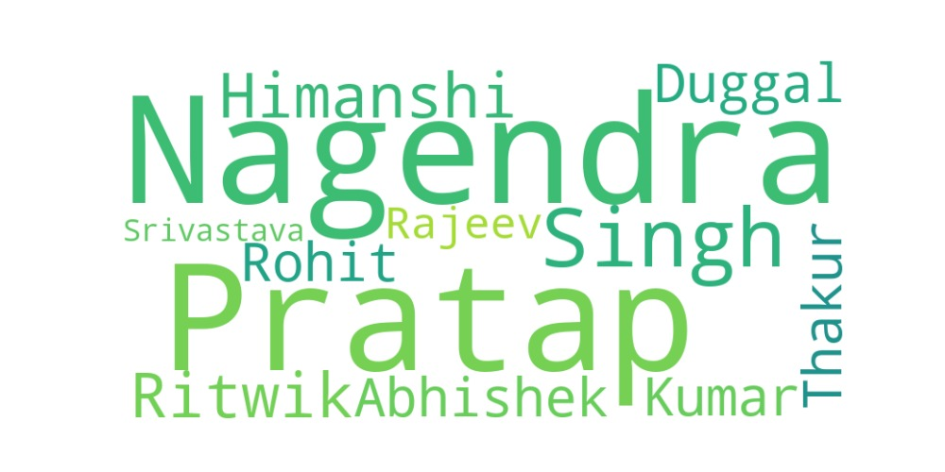
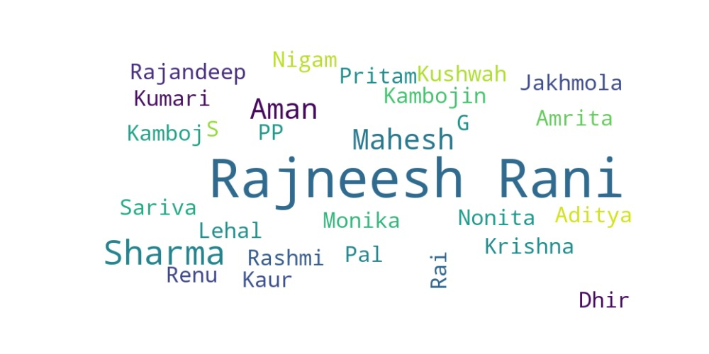
FOR BOOK CHAPTERS
HARSH KUMAR VERMA SIR
NAGENDRA SIR
RRAJNEESH RANI MAM

Slide 25
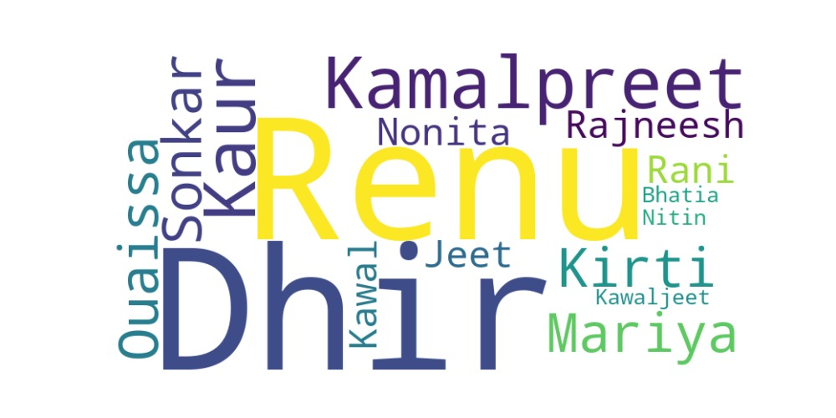
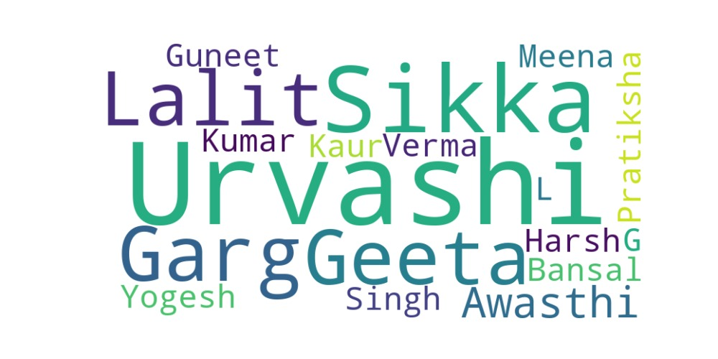
RENU DHIR MAM
URVASHI MAM

Slide 26
BAR CHART
Data is visualized FOR COMPARISION of various faculty in a particular field

Slide 27
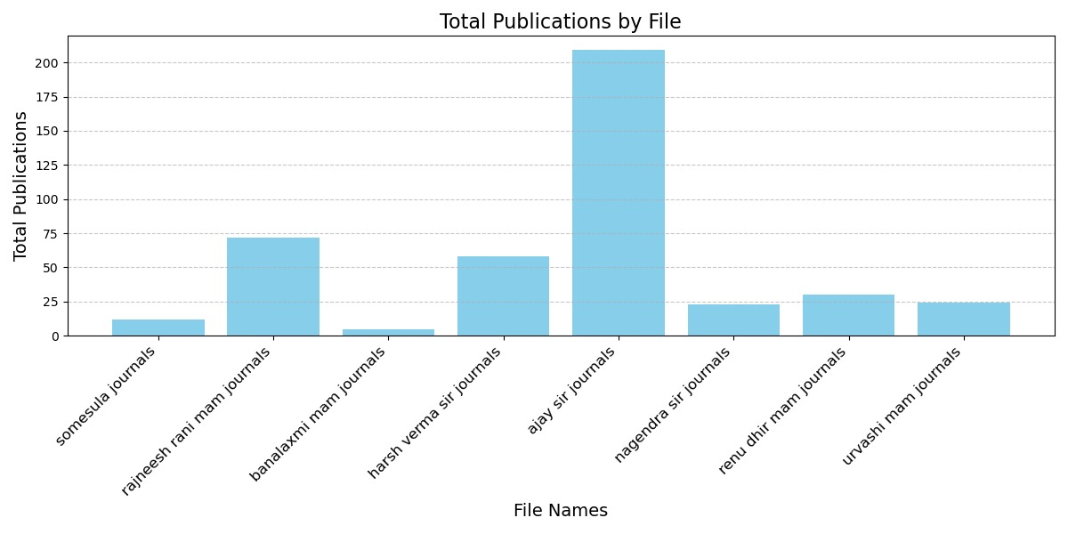
FOR JOURNAL

Slide 28
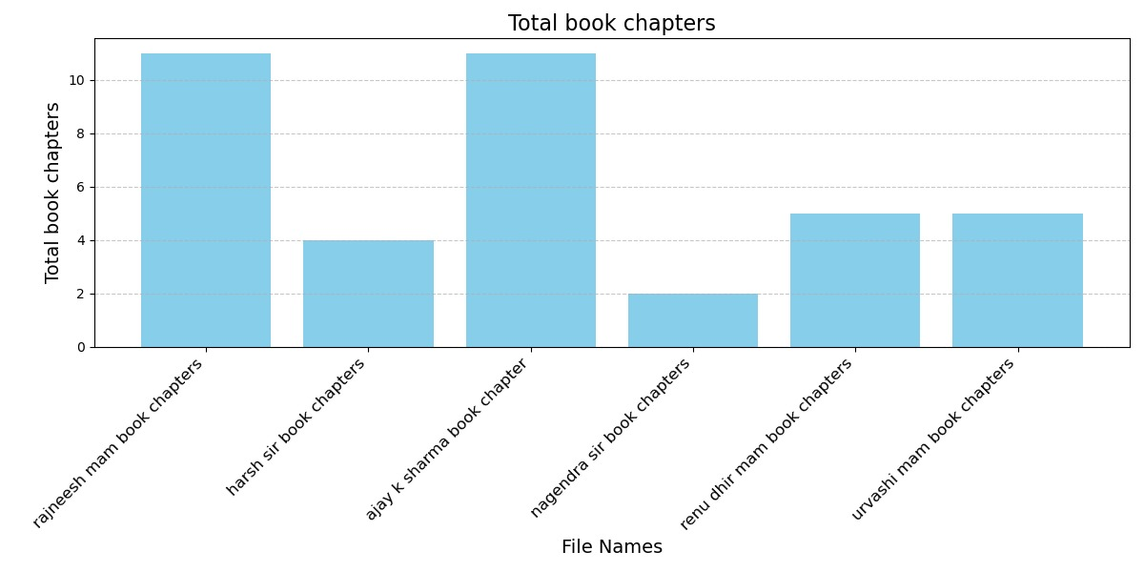

Slide 29
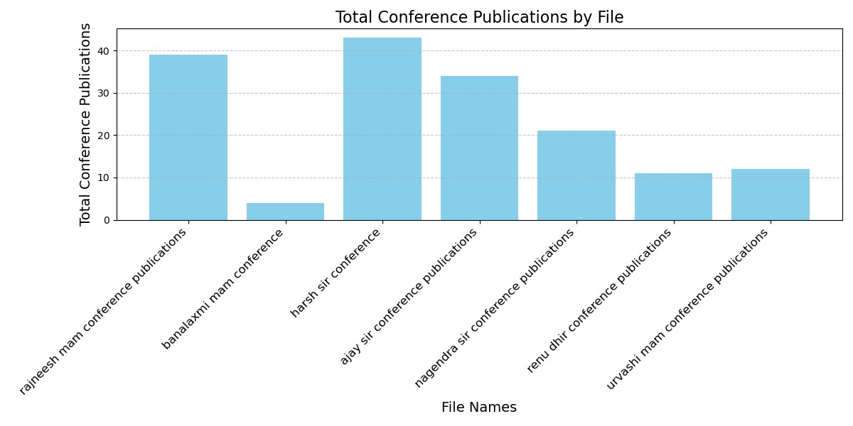

Slide 30
STACKED BAR CHART
A stacked bar chart is used to show how different categories contribute to a total across multiple groups. It combines the benefits of a bar chart and a pie chart by representing part-to-whole relationships while also comparing multiple groups.

Slide 31
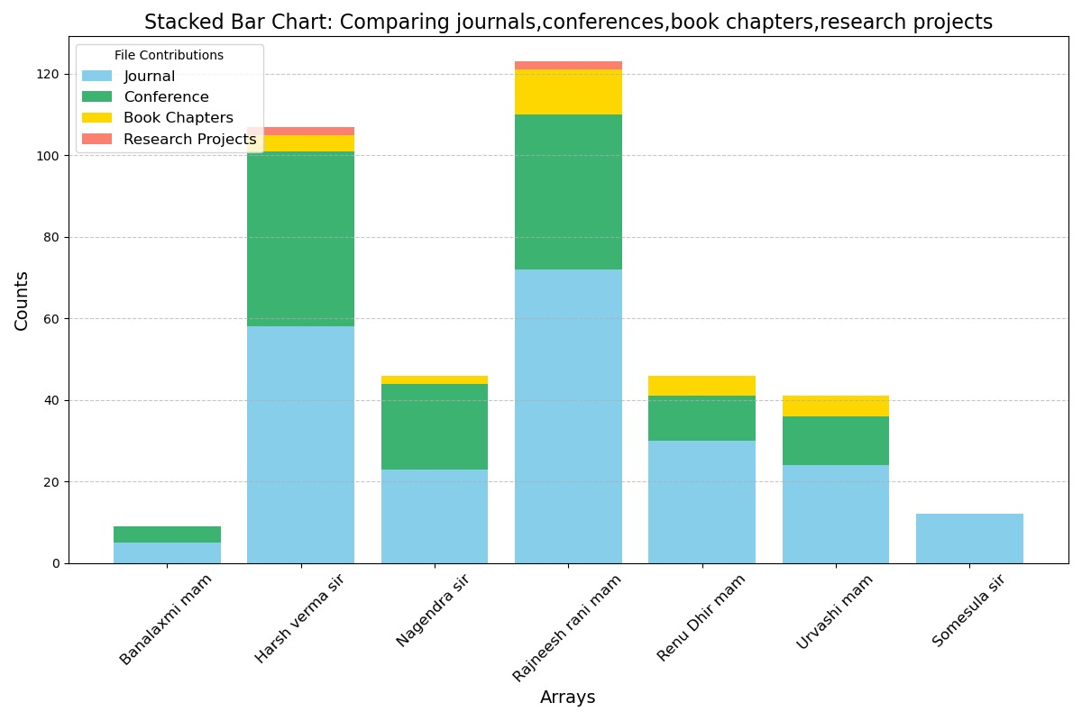

Slide 32
SANKEY DIAGRAM
A Sankey diagram is used to visualize flows or relationships between different entities or stages, focusing on the magnitude of flows between them. It is particularly effective for representing data with processes, hierarchies, or relationships where there are multiple paths or divergent and convergent flows.

Slide 33
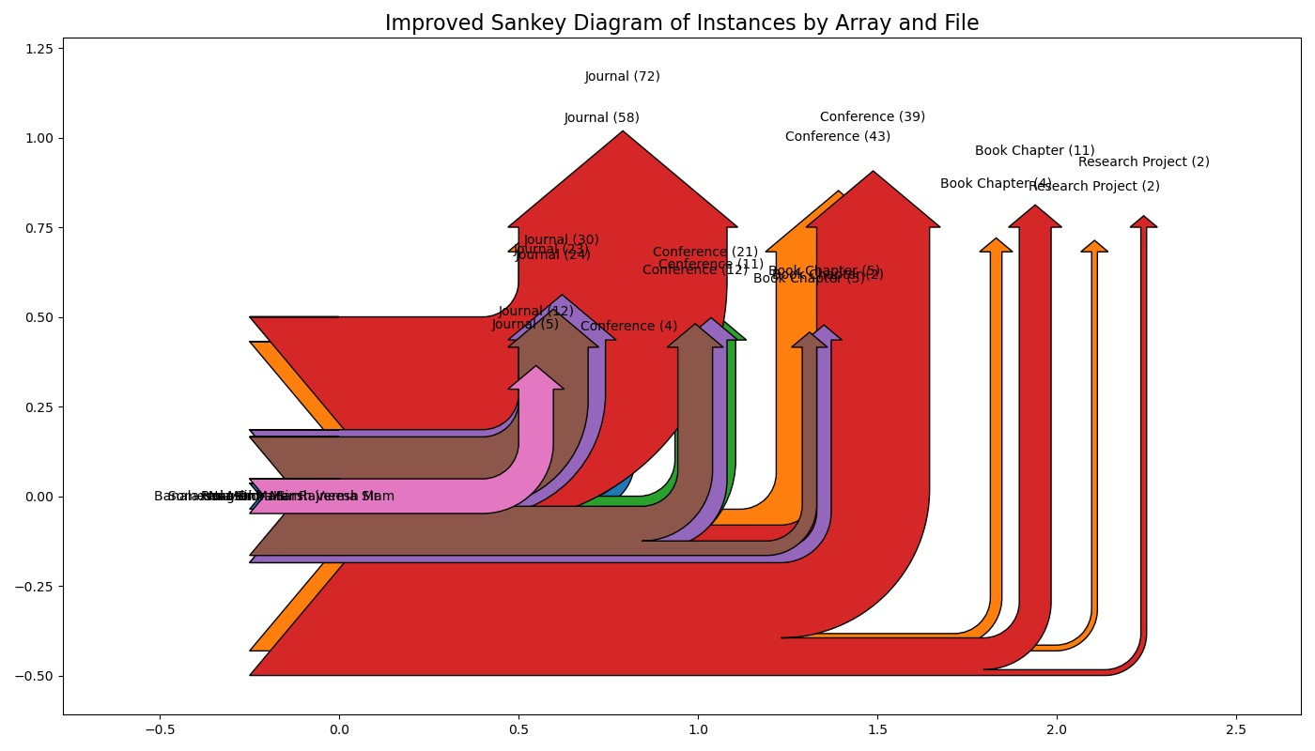

Slide 34
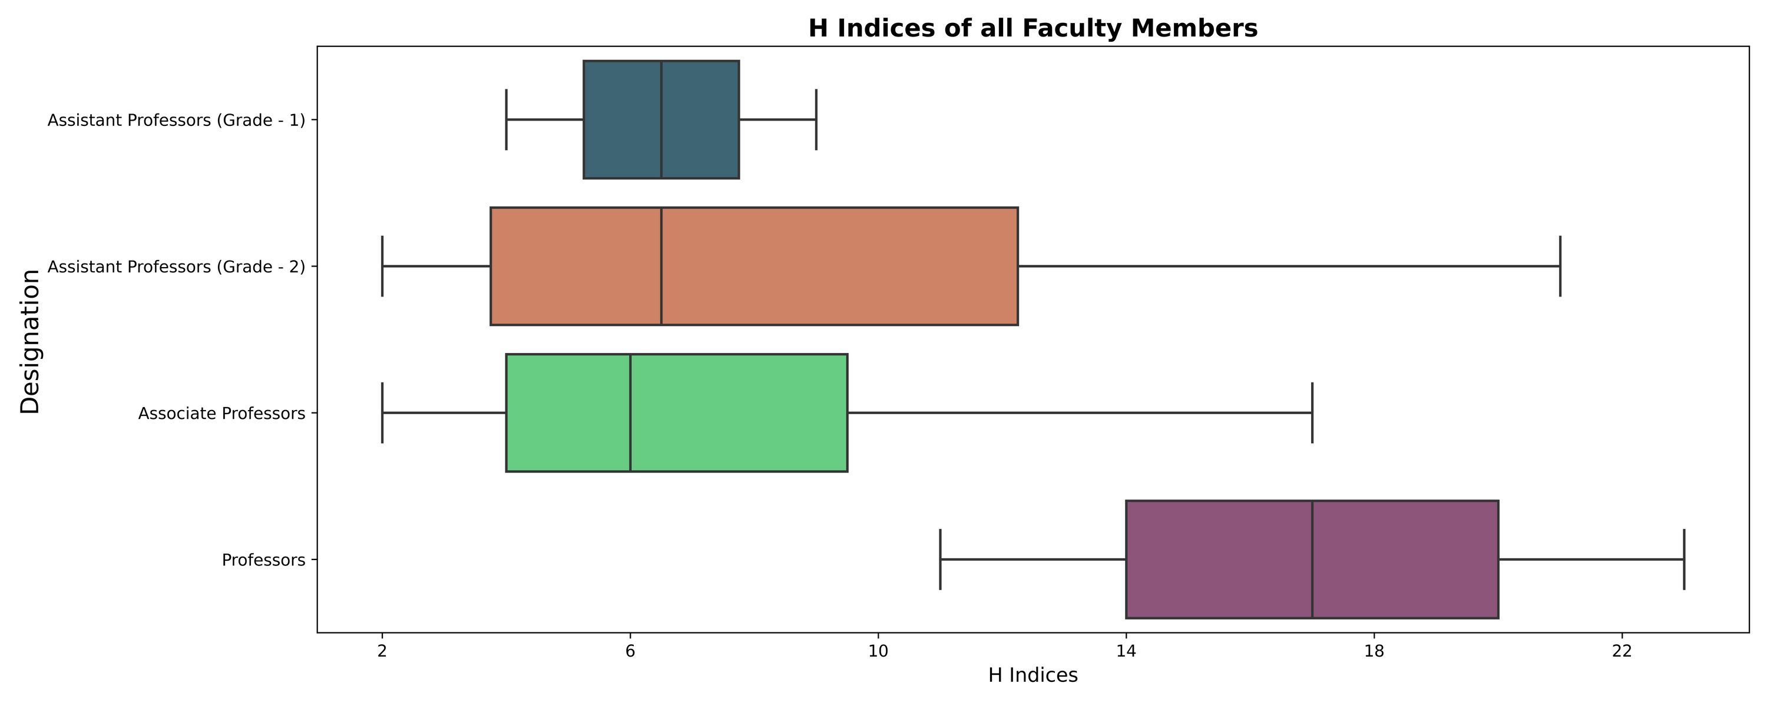
H indices of all Faculty Members
Box Plot

Slide 35
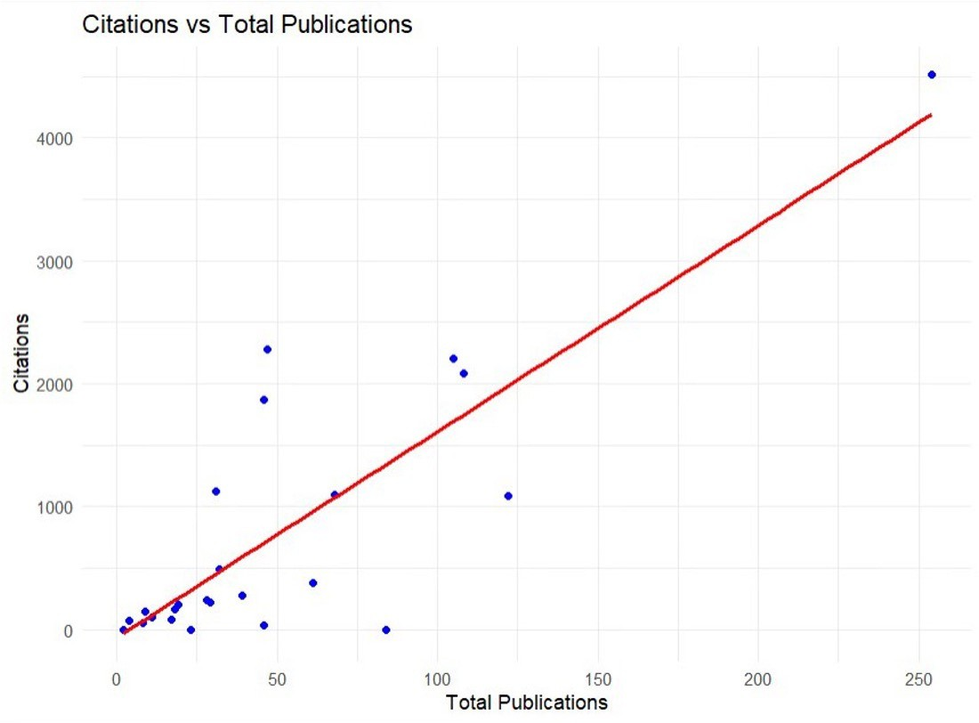
Scatter Plot between Citations and Total Publications
Scatter plot

Slide 36
Challenges and Limitations
Despite the valuable insights gained through data visualization, there are certain limitations that we encountered:
Data Availability: Limited access to comprehensive datasets restricted the scope of our analysis.
Bias in Data: Certain biases, such as selection bias, could affect the validity of the results.
Interpretational Differences: Different researchers may interpret the same data differently, leading to varying conclusions.

Slide 37
Thanks
Alba Castro

